Slide 1
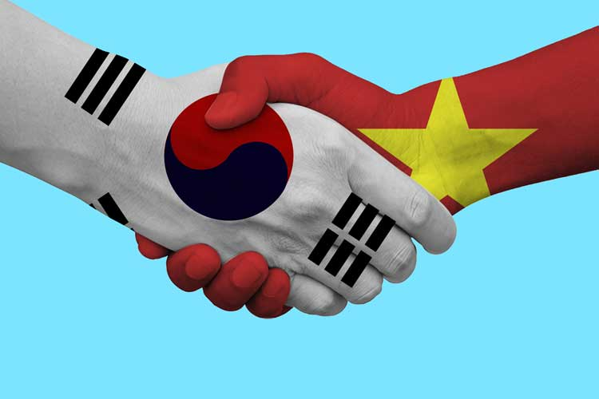
베트남의 명절좀:
What do Vietnamese do during “TET’ holiday?
베트남민족
베트남의설날
Notes:
베트남의설날:
What do Vietnamese do during “TET’ holiday?

Slide 2
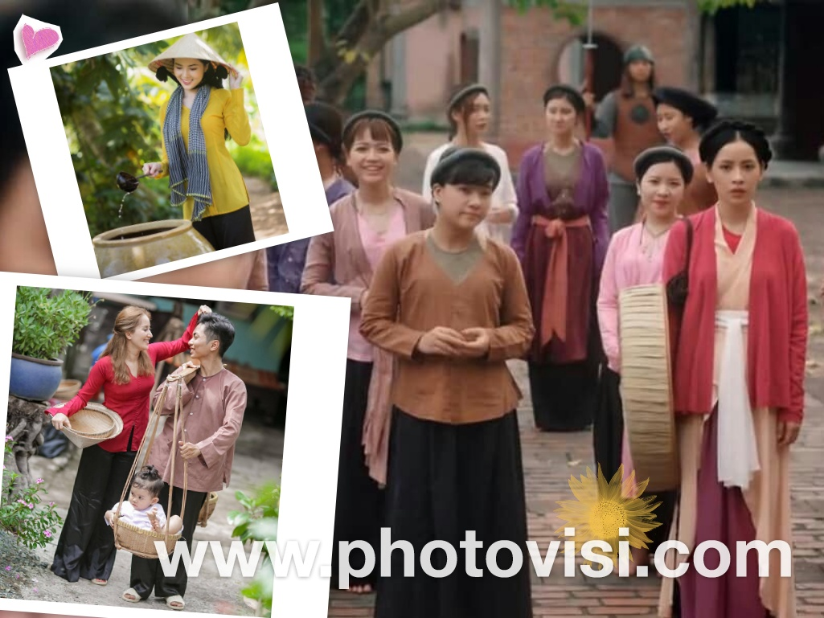
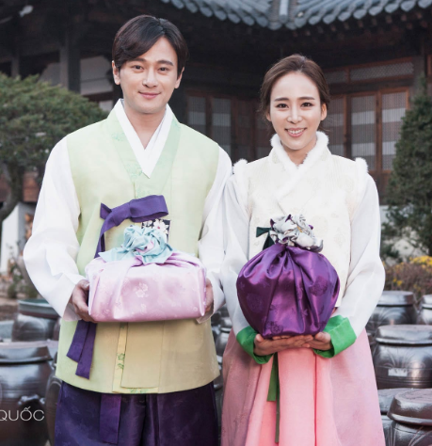
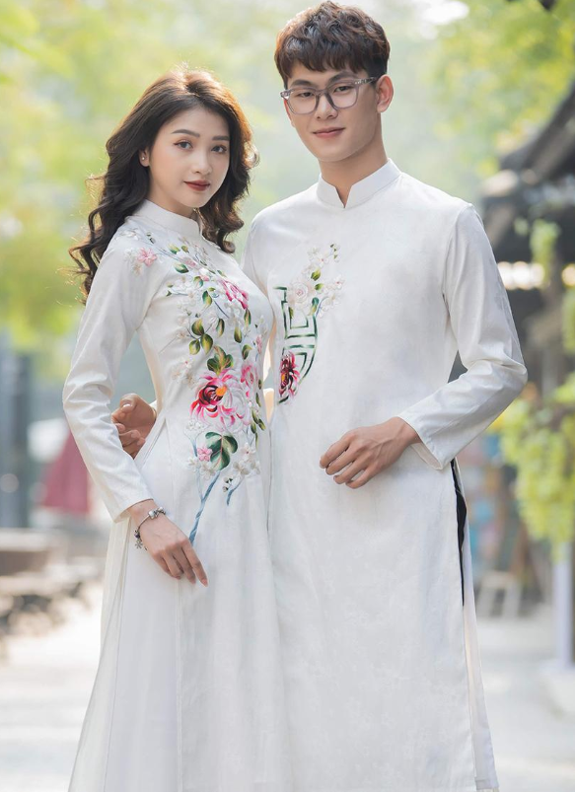
베트남민족
 | 대한민국 | 베트남
사람 | ~50mil (대한민국) ~25mil (북한) one ethnic | ~100mil 54 ethnic groups (China - 56 ethnic) main ( Kinh people)
전통의상 | 한복 | 베트남복 Áo tứ thân (four-part dress) Áo dài (long dress) Áo bà ba (the shirt of Mrs)
Notes:
https://www.vietvisiontravel.com/post/tet-holiday-vietnamese-new-year-festival/
https://www.photovisi.com/vi/photovisi/angled-side-by-side

Slide 3
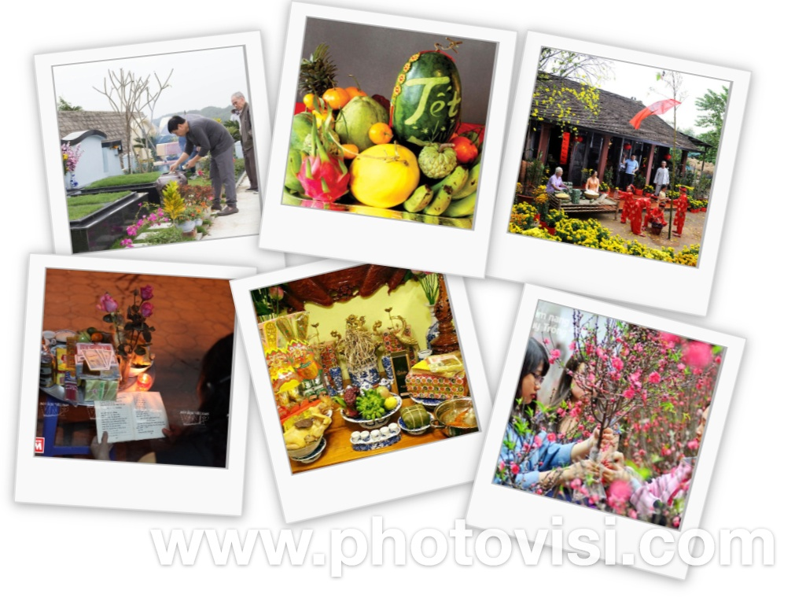
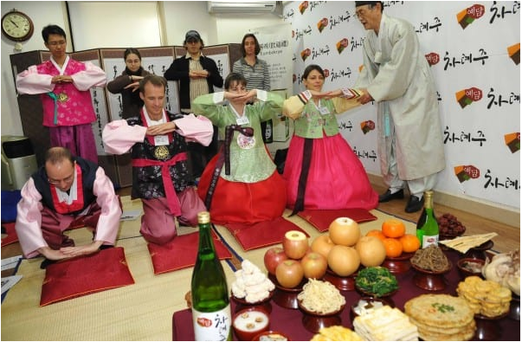
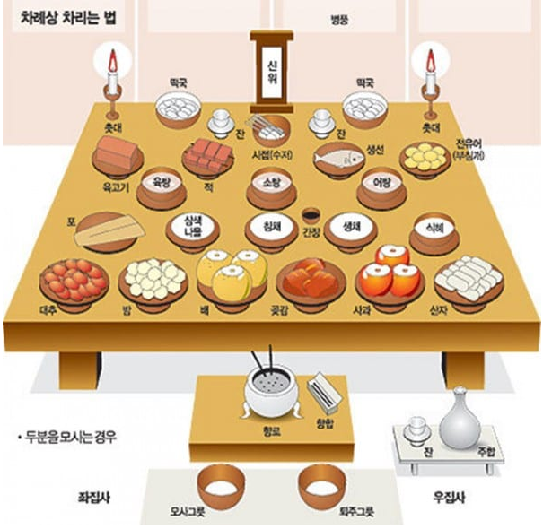
설날 이벤트
성묘 ( tao mo)
Tray of Five Fruits
Neu Tree
Flowers: Dao, Mai
Notes:
Visiting relatives, friends, colleagues, neighbors

Slide 4
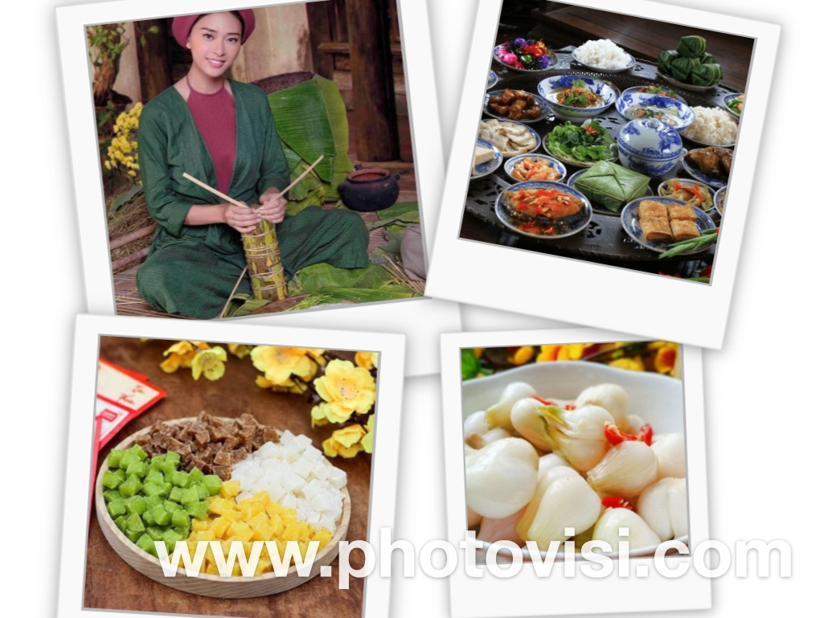
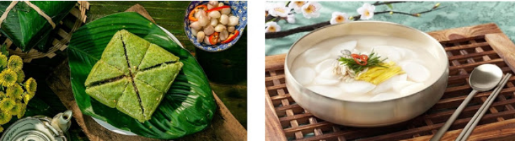
설날 이벤트
설날음식
Chung cake
Pickled onions: 베트남 김지
Jam
Notes:
Visiting relatives, friends, colleagues, neighbors

Slide 5
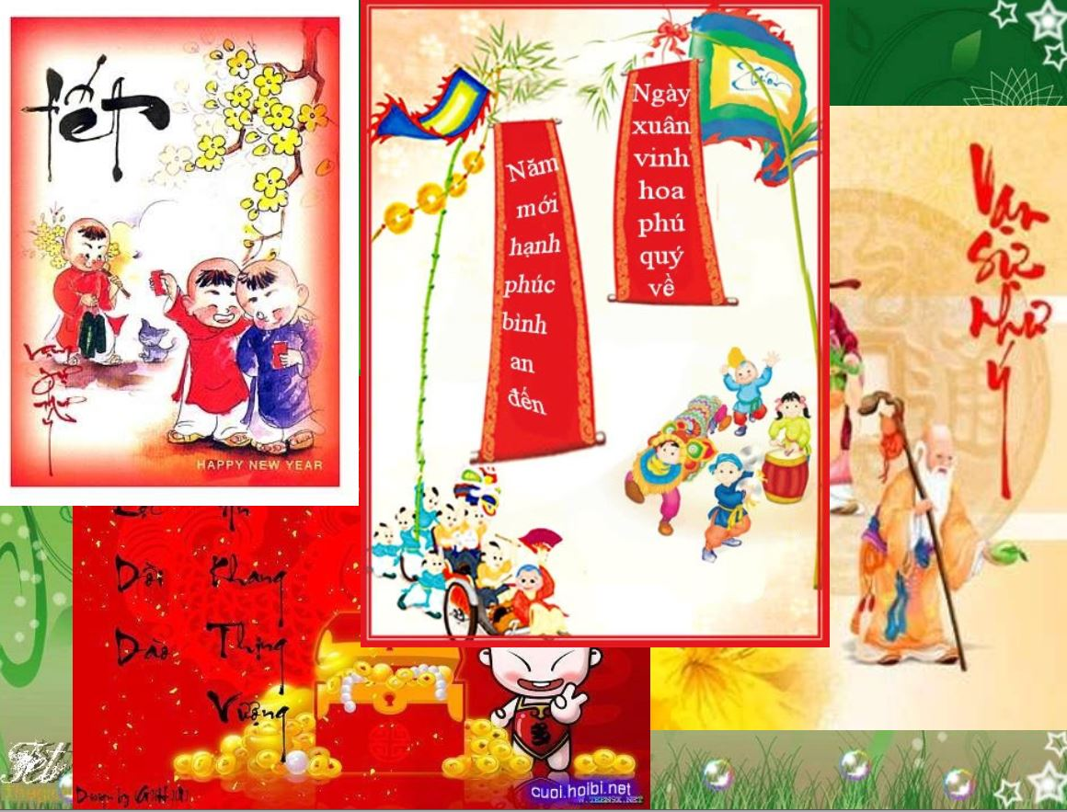
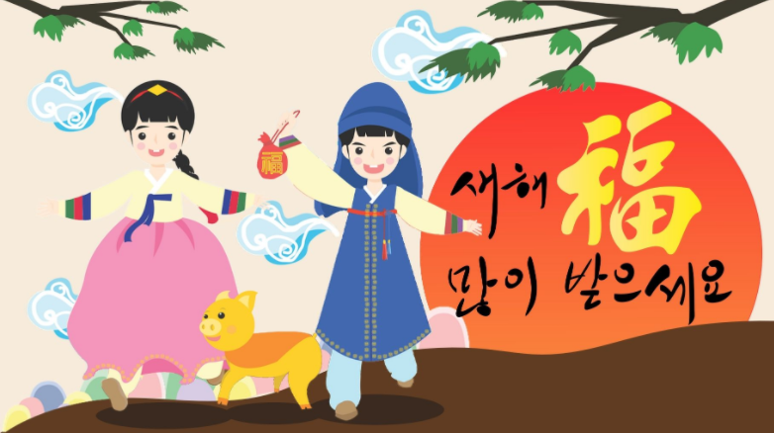
설날 이벤트
Greeting(새해 복 많이 받으세요):
Live up to 100 years
Security, good health, and prosperity
萬事如意 (Van su nhu y)
Plenty of health
恭喜发财 , 恭喜發財 (Cung hy phat tai)
Notes:
Visiting relatives, friends, colleagues, neighbors

Slide 6
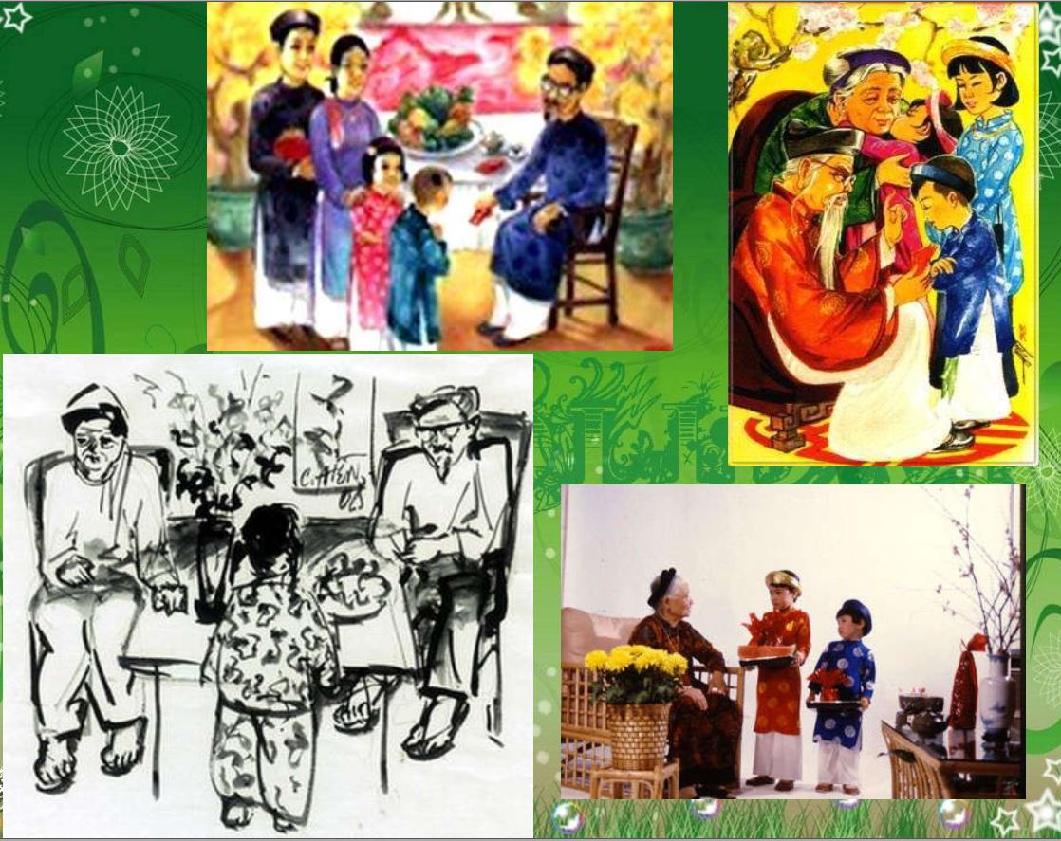
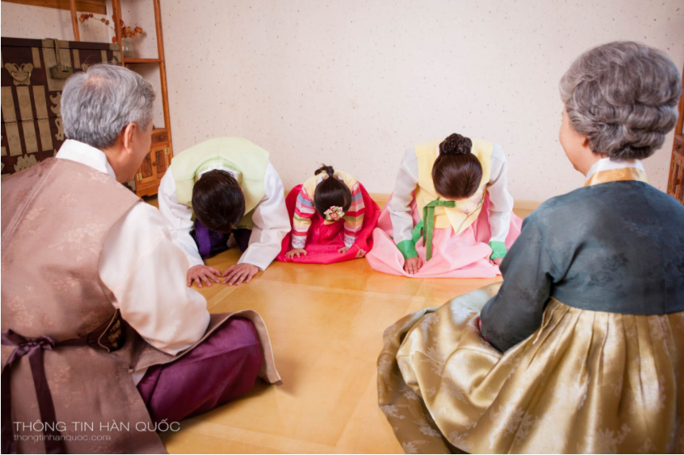
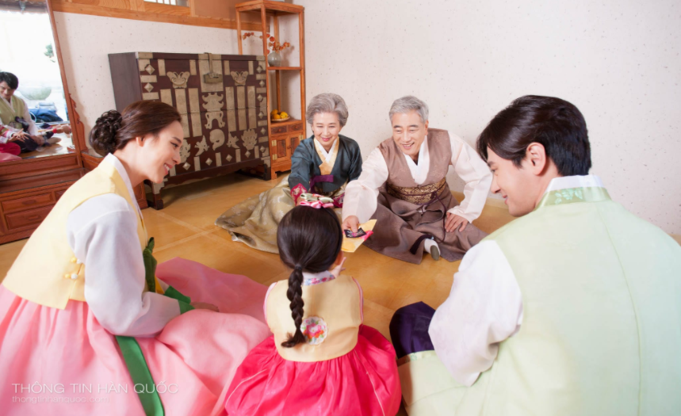
설날 이벤트
친척 (ho hang)
세뱃돈
Visiting relatives, friends, colleagues, neighbors
The first day is father’s Tet
The second day is mother’s Tet
The third day is teacher’s Tet
Notes:
Visiting relatives, friends, colleagues, neighbors

Slide 7
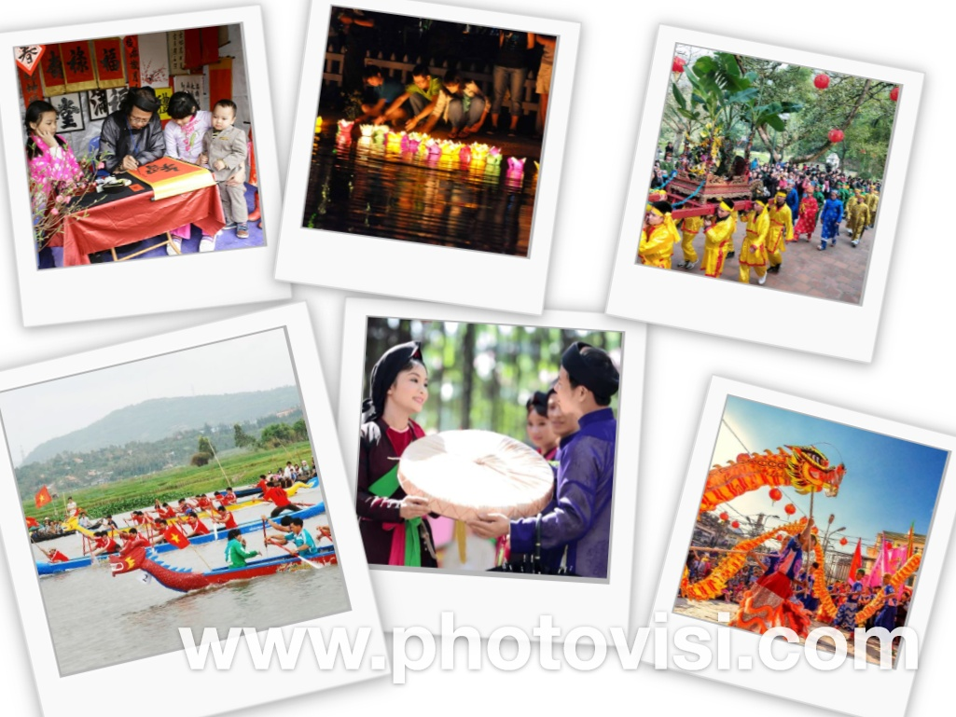
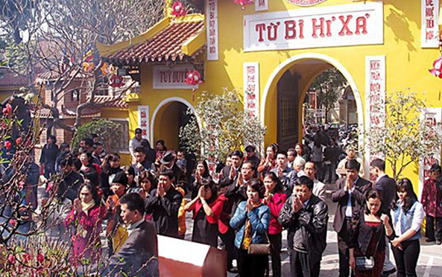
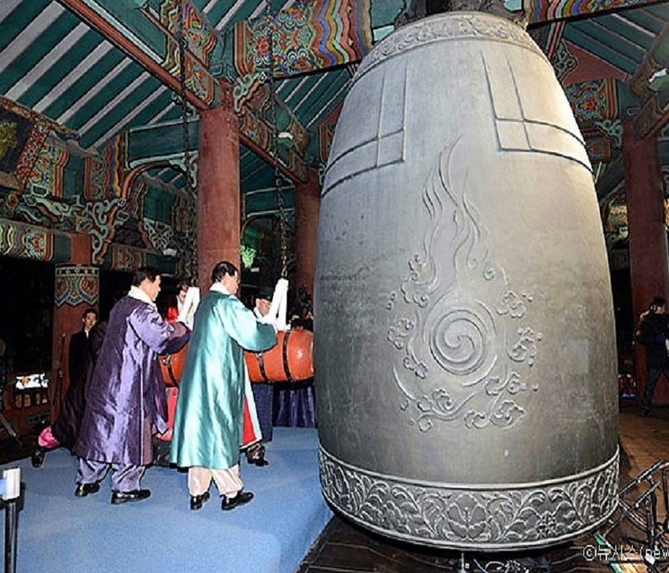
설날 이벤트
Go to pagodas to pray
파고다의 전통축제
Notes:
Đánh chuông Bosingak

Slide 8
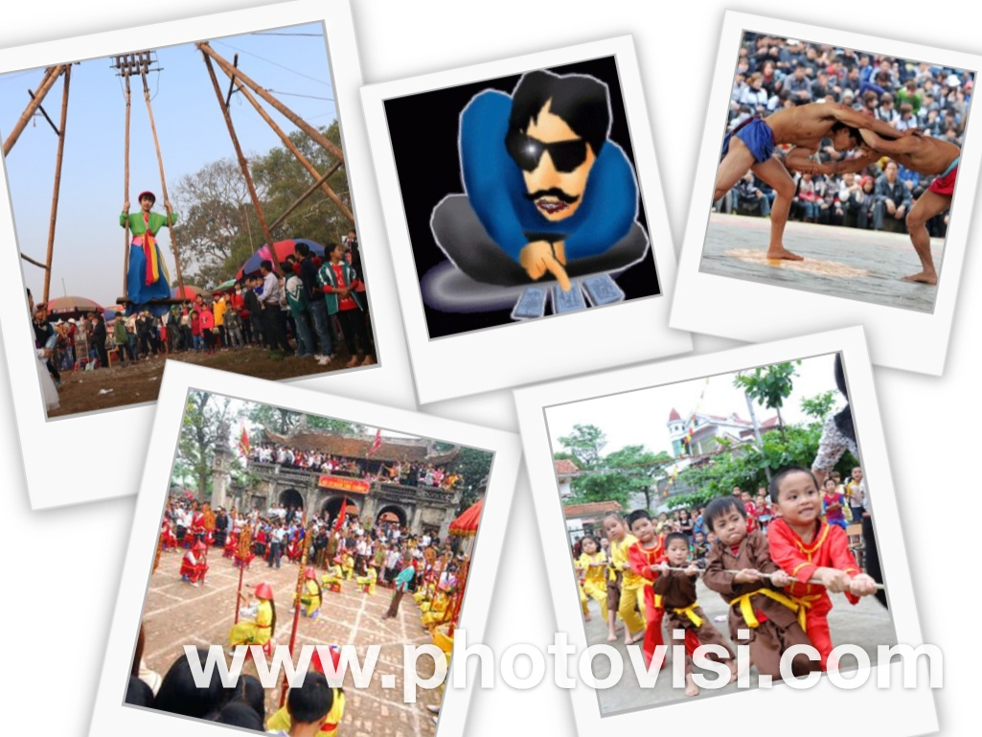
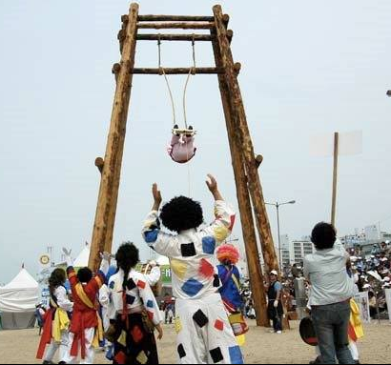
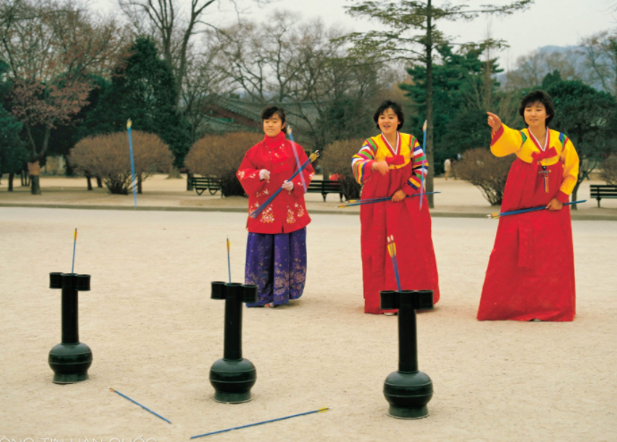
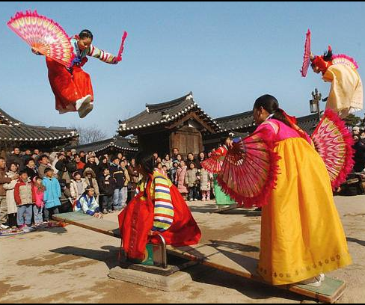
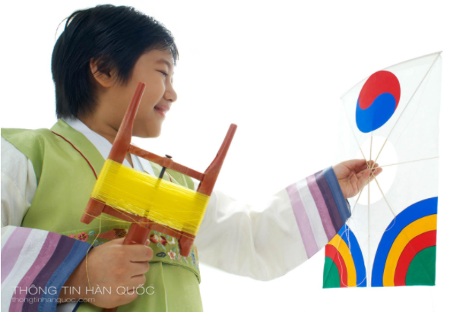
설날 이벤트
전통놀이
Notes:
Tuho – Trò chơi ném tên Trò chơi bập bênh (neoltwiggi) Yutnori (chơi gậy)

